Slide 1

ISDS 552 GP3
TEAM MEMBERS:
DEEPAM KHIRWAR
HARSHITA DIDWANIA
KAVINDU WALIMUNIGE
SANCHIT SINGH
SATHIYA PRIYA JEEVANANDAN

Slide 2
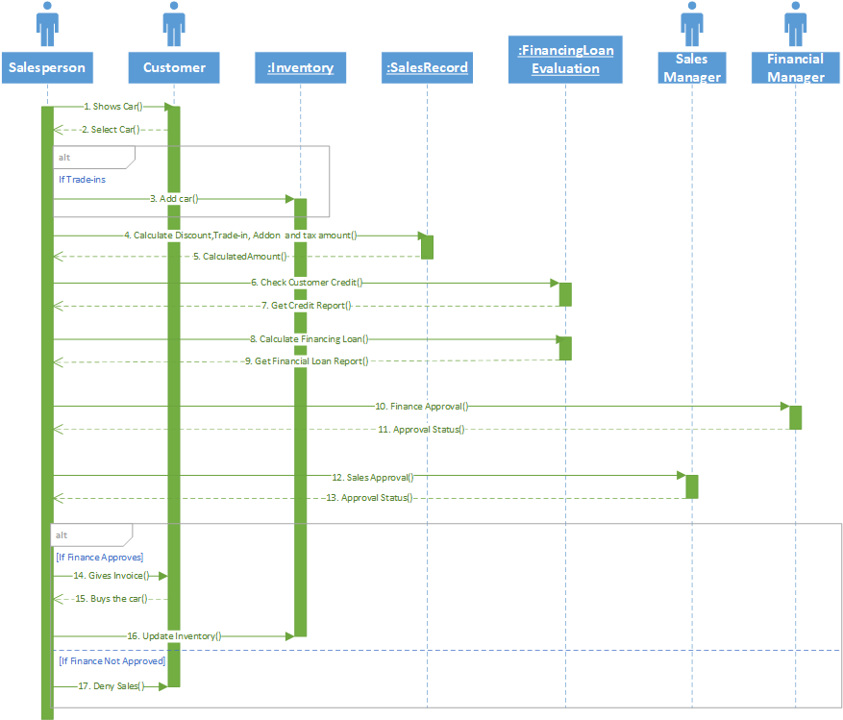
SEQUENCE DIAGRAM- SELL CAR

Slide 3
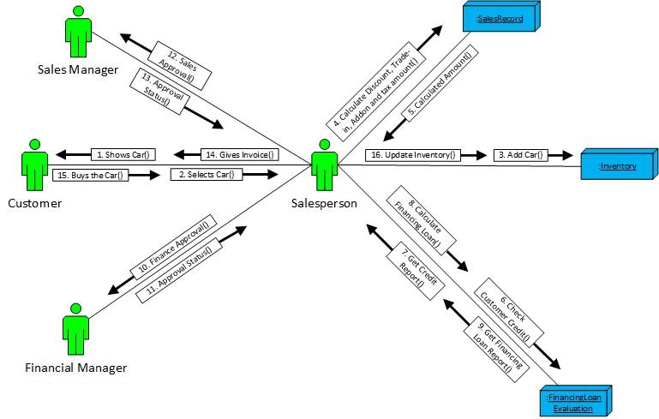
COMMUNICATION DIAGRAM- SELL CAR

Slide 4
End of presentation
Thank you!

